Slide 1
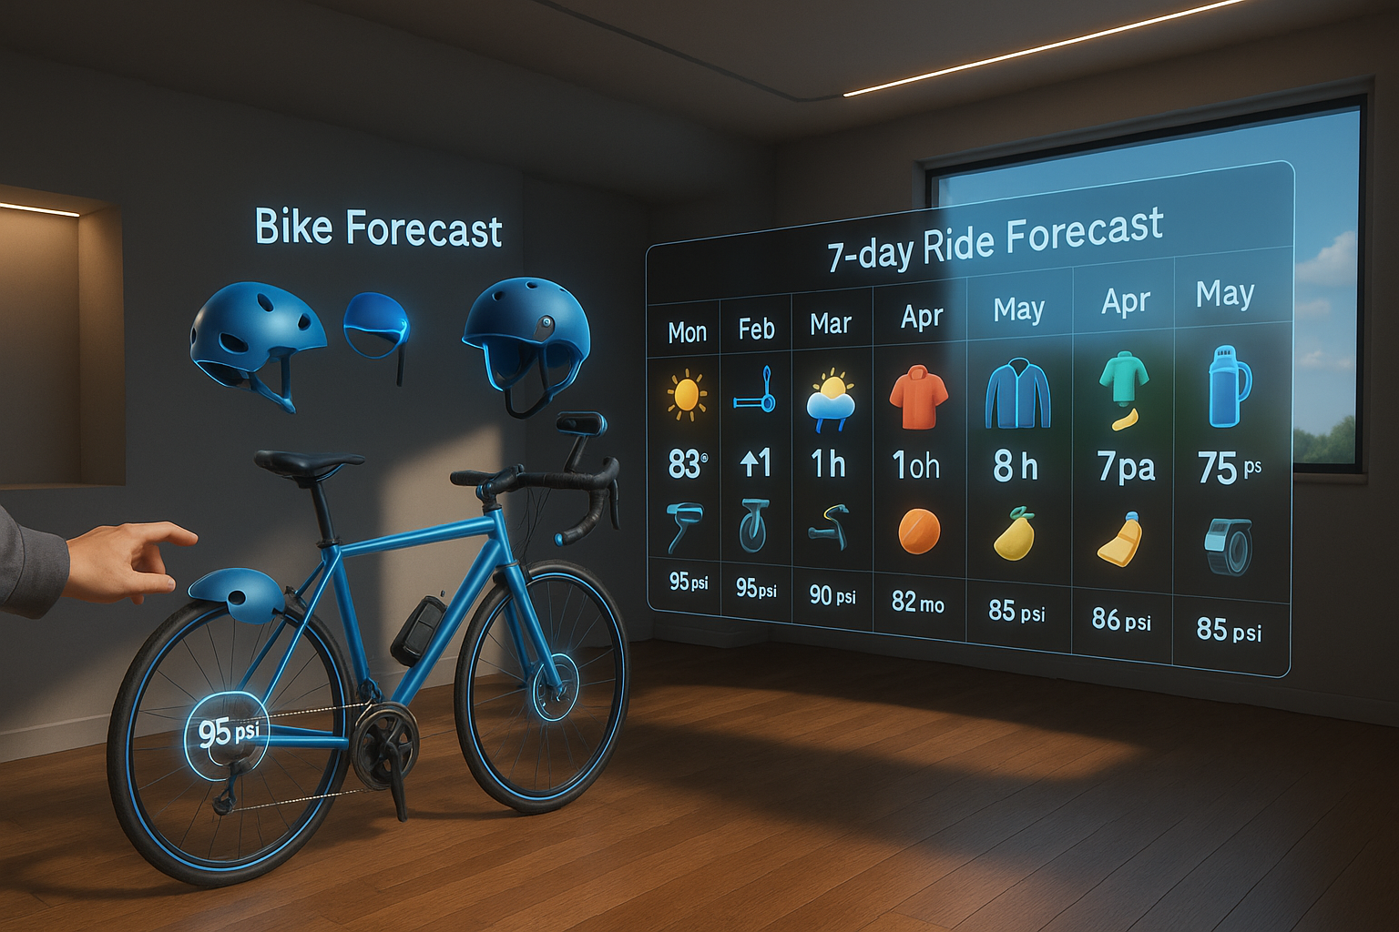
Biking Forecast & Planner XR
A mixed reality ride planner that helps cyclists optimize weather, gear, and nutrition before heading out.

Slide 2
Problem
Cyclists face unpredictable weather, nutrition mistakes, and ride delays — often without knowing until it's too late.

Slide 3
Concept
A mixed reality biking planner that helps you optimize your ride before you even step outside. Choose your bike, configure your gear, and based on weather forecasts, it recommends your best departure time and estimates your arrival speed. The app also provides nutrition guidance — telling you what to eat, when, and where during your ride.

Slide 4
Overview Diagram
Choose bike → Add gear → Check forecast → See ETA/nutrition → Enter simulation

Slide 5
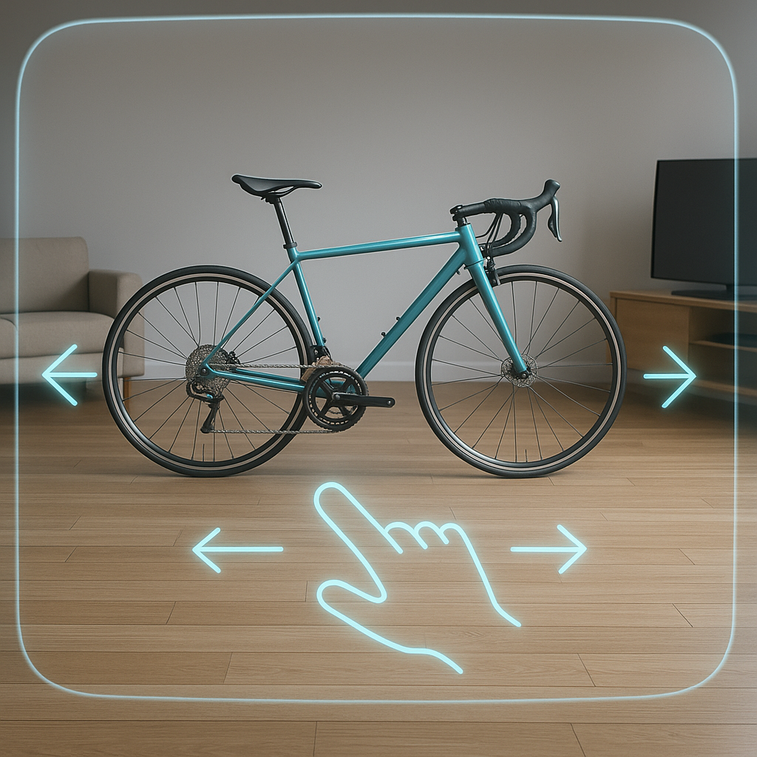
Swipe through bike types
Right in your real room lies a virtual bike with hints that you can swipe through different bike types be it hybrid, BMX, mountain, road bikes, and more..

Slide 6
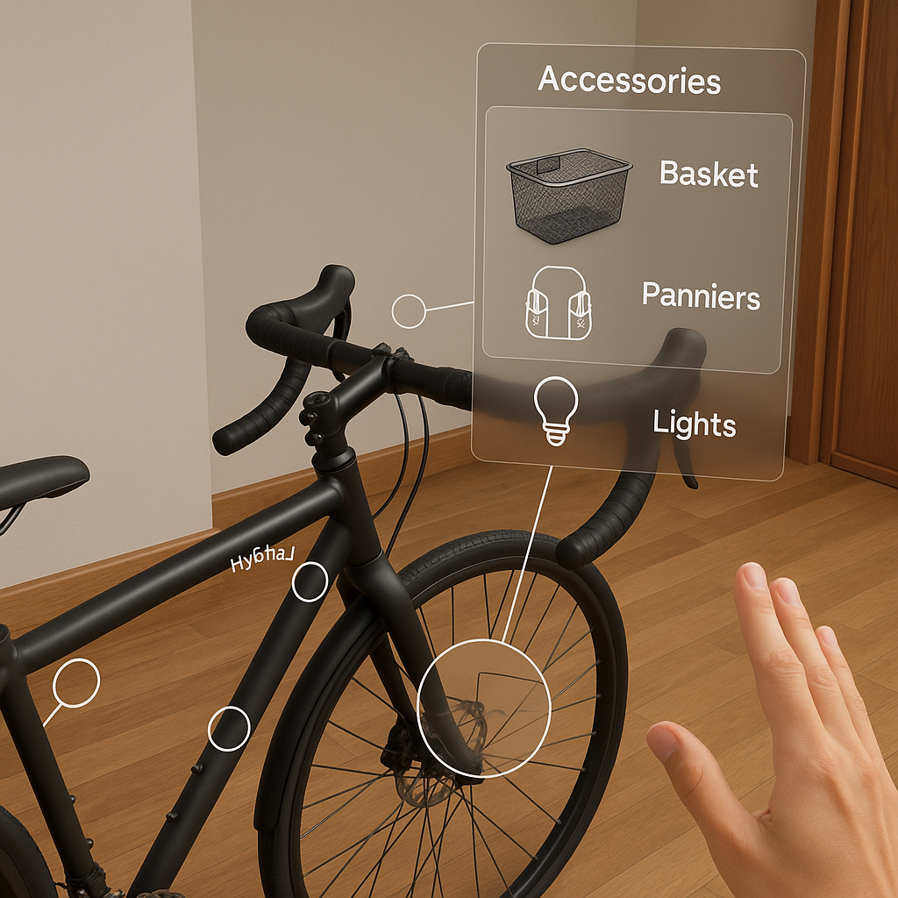
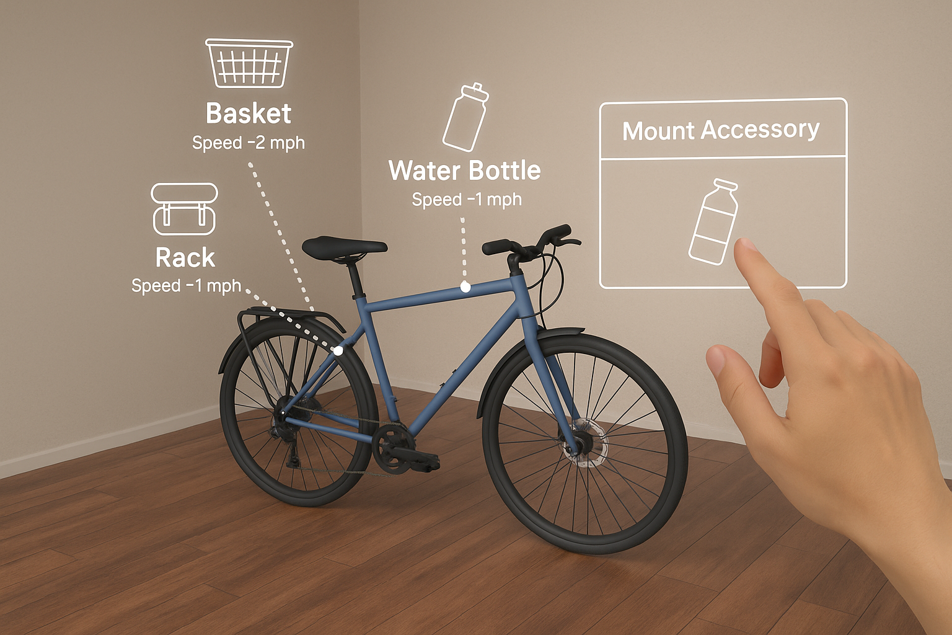
Tap to add/remove accessories
There will be visual cues of mounting points on the virtual bike that you can tap it and it will give you options organized by categories of accessories you can put on your bike which will also show you the speed penalty you’ll lose.

Slide 7
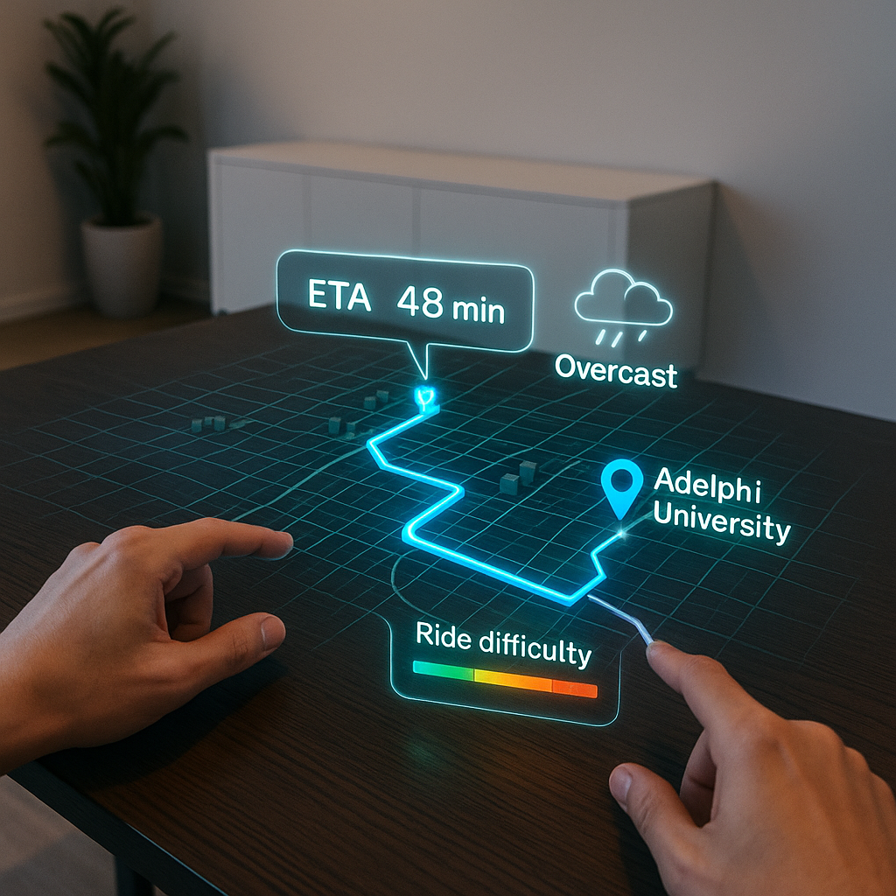
Choose Route and Destination
Select your ride destination on a spatial map or through voice input. The app calculates your route, estimates travel time, and overlays forecast, difficulty, and nutrition planning.

Slide 8
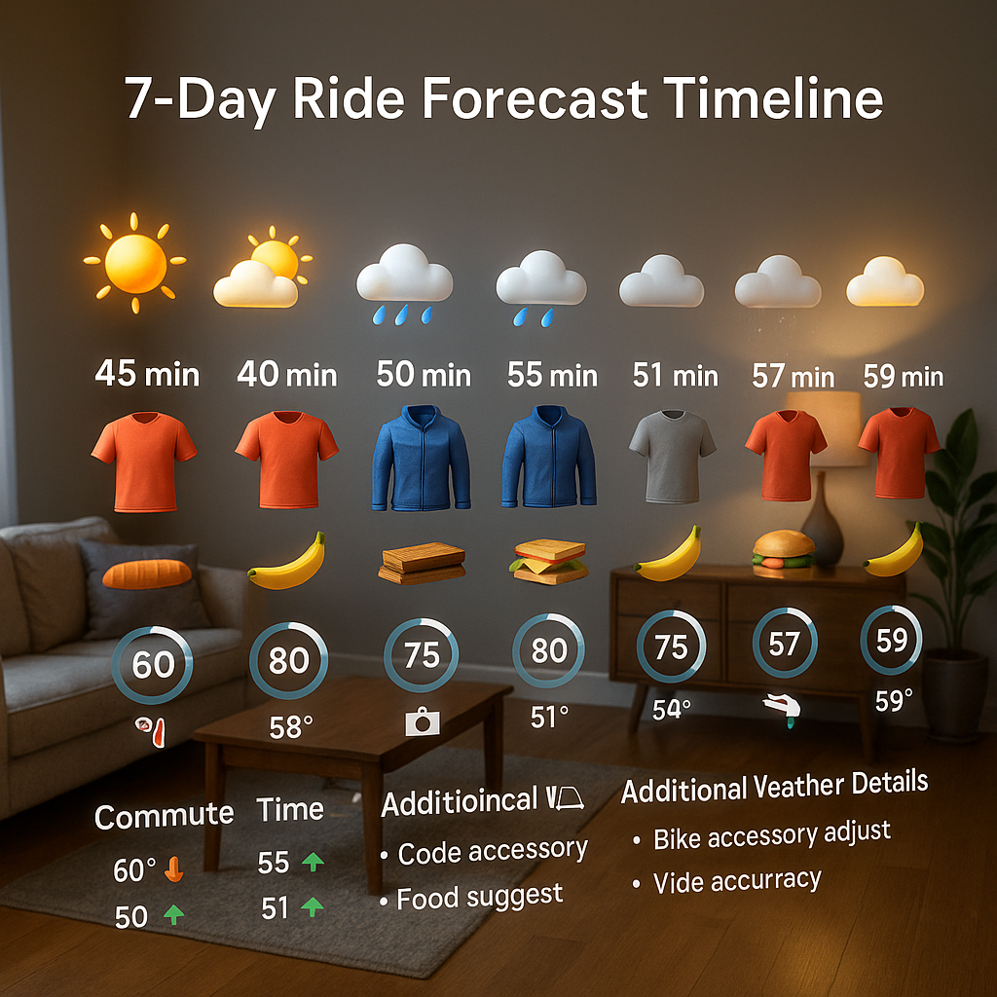
7-Day XR Ride Forecast Timeline
A horizontal mixed reality display showing ride conditions, weather, nutrition, and gear tips for the entire week — all stacked by day, floating in your space.

Slide 9
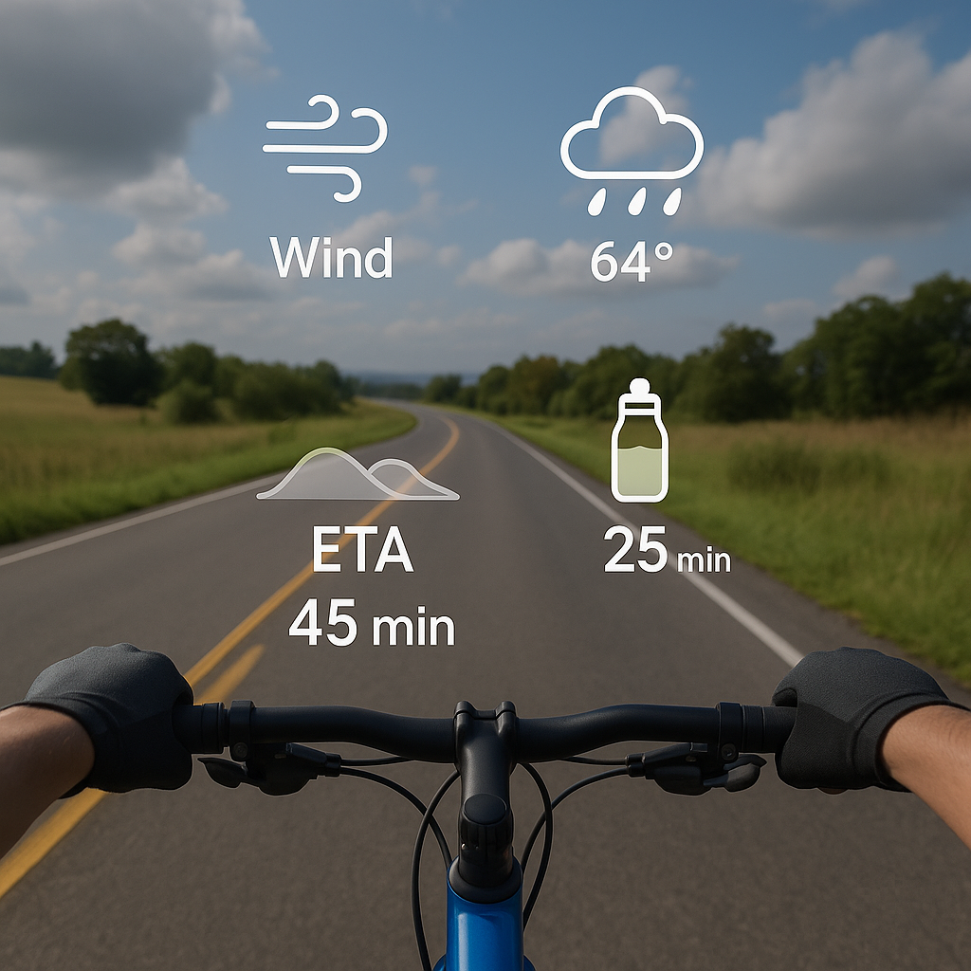
Simulation mode
Touch the bike’s handlebars to enter VR mode and preview your ride. You’ll see a first-person view of the route ahead, complete with a heads-up display showing real-time conditions like wind, terrain, weather, ETA, and nutrition checkpoints.

Slide 10
User Interactions Overview
Action | Result
Swipe bike | Change bike type (hybrid, BMX, mountain, etc.)
Tap accessory mount | Preview gear + speed impact
Walk timeline | See 7-day forecast and ETA comparisons
Pinch on a spatial map on a table (whether overlaid on a physical or a virtual table) | Zooms in or out
Tap on line segments | Changes the route
Tap on an accessory mounting point | Gives you the option to add/remove accessories for that mounting point
Hold onto bike’s handlebars | Enters VR simulation mode

